Slide 1



Malineni Suseelamma Women’s Engineering College Affiliated to JNTUK,KAKINADA and Approved by AICTE,New Delhi SINGARAYAKONDA-523 101, Prakasam Dt.,(A.p )
Team Members
v.Chandrika
K.JASWITHA
M.KUSHMA
N.V.SREELATHA
T.NIVEDITHA
V.RENUKA

Slide 2

PROBLEM STATEMENT
Automated Gas Leak Detection &Alert System
SOLUTION:
Detect dangerous gas concentration (e.g., LPG/propane, methane, smoke) and
when a leak is detected:
Immediately close a gas solenoid/valve (cut supply).
Open a door/window (or trigger ventilation) automatically
Sound an alarm and optionally send a notification (Wi-Fi).
Provide manual override and visual status

Slide 3
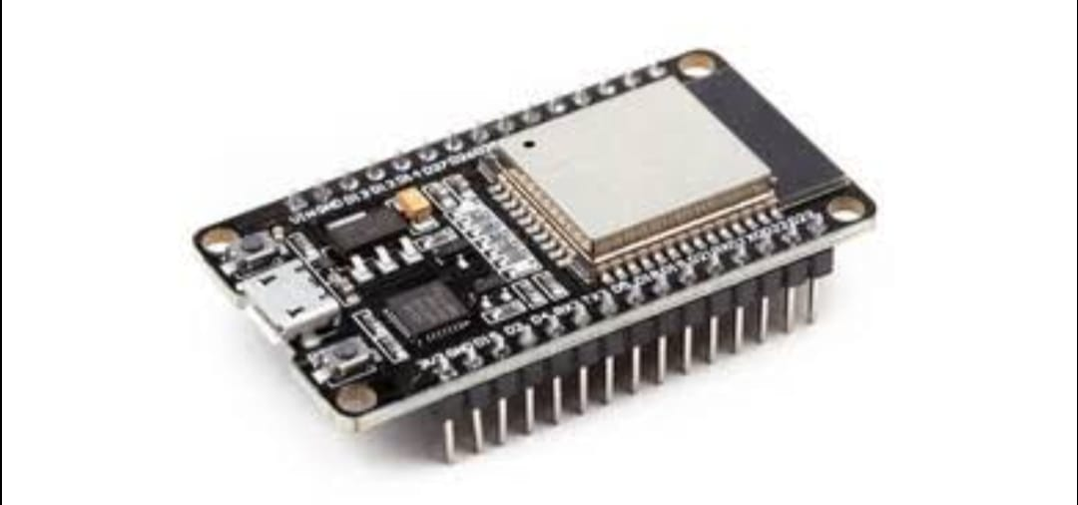
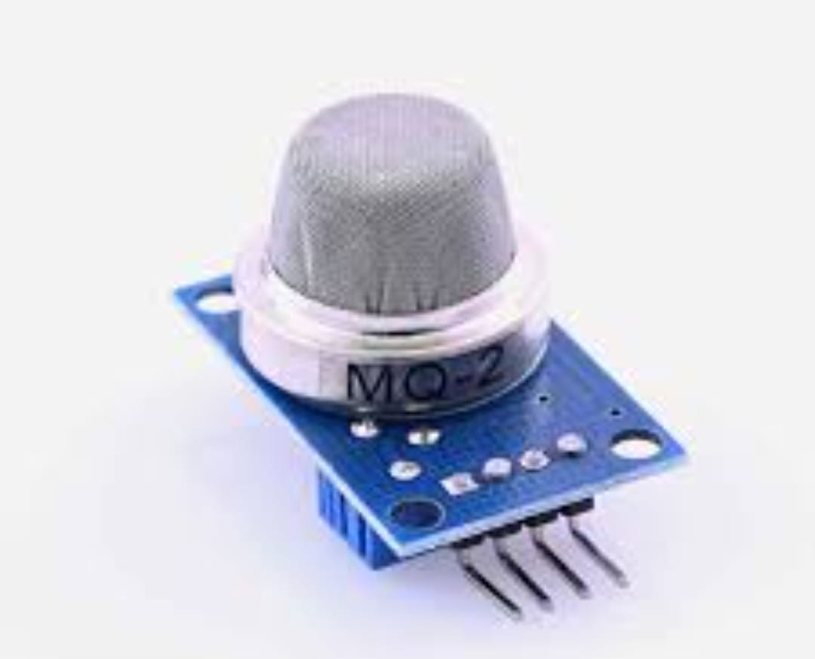

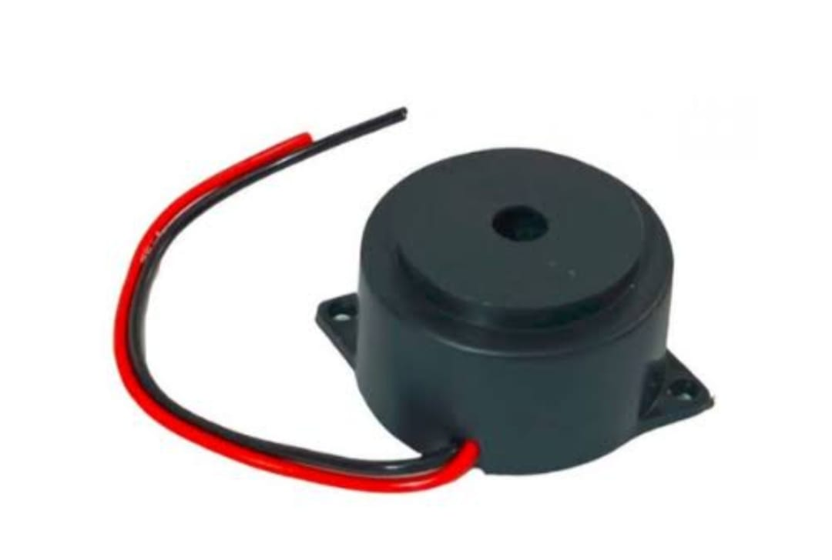
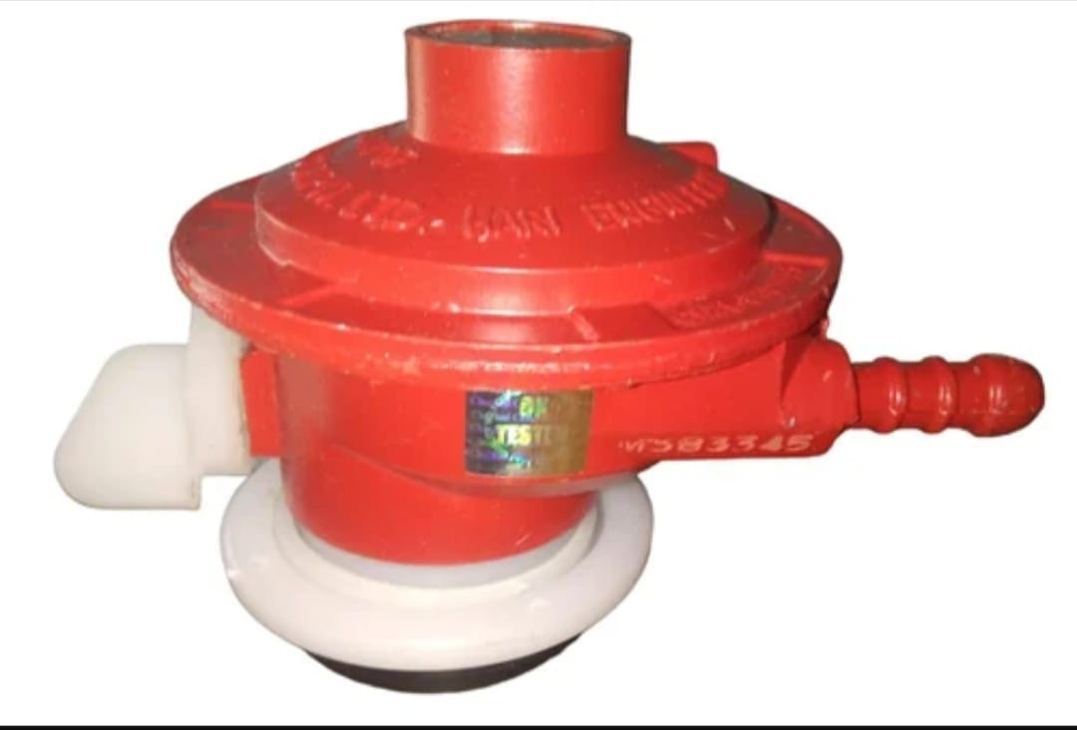
Components
ESP32
Gas Sensor
Servo motor
Buzzer
Lpg Gas Regulator

Slide 4
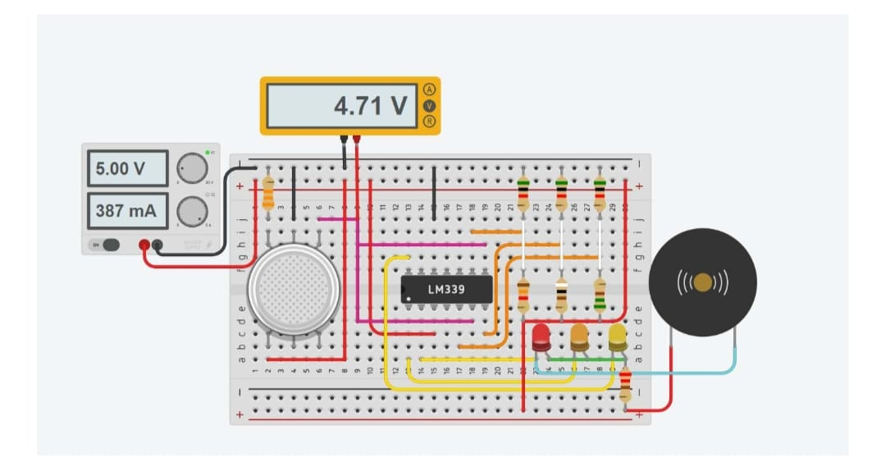
Wiring Connections
Power & Sensors
ESP32 3.3V → sensor Vcc (some MQ modules are 5V — check module; MQ raw sensors require heater voltage recommended per module docs)
Gas sensor analog output → ESP32 ADC pin (e.g., GPIO 34)
Buzzer → GPIO through transistor driver (or use active buzzer) + transistor + diode
Valve Control
Relay module IN → ESP32 GPIO (e.g., GPIO 26); relay Vcc powered by 5V supply; opto-isolated relay preferred
Valve power → external power supply switched by relay (valve + supply isolated from ESP32)

Slide 5
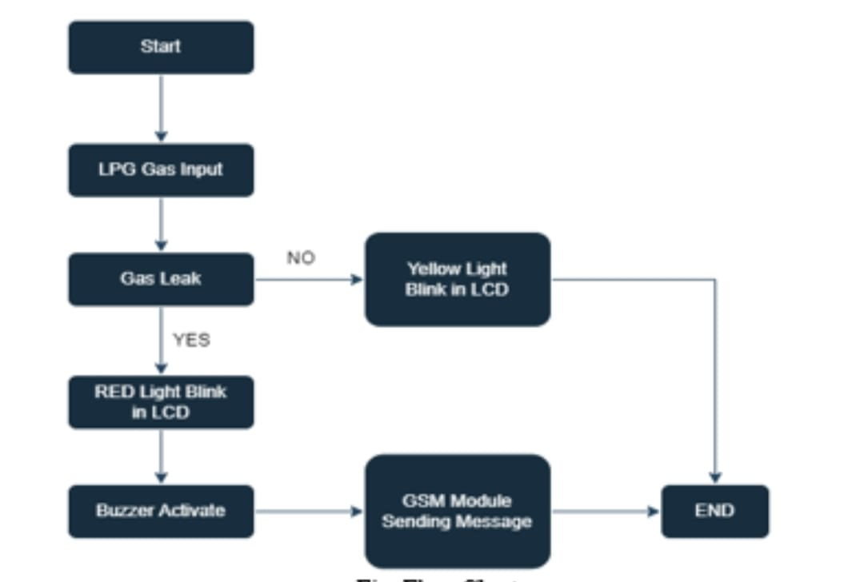
Testing Procedure (safe)
Code deploy to ESP32
verify serial logs and sensors.
Verify relay operation
without connecting valve (listen/see relay activation).
Test servo/actuator movement independently.
Wire valve and do dry-run activation
in safe area (no gas) to ensure valve actuates correctly.
Use a small controlled gas source
for detection tests in an open, ventilated area. Avoid sparks and flames. Prefer using calibration gas canisters if available.
Confirm manual reset behavior
and Wi-Fi notifications.
Test power failure behavior
ensure the system goes to safe state (valve closed) or manual valve takes over.

Slide 6

KEY FEATURES
Multi-gas sensing: Detects various gases such as LPG, methane, carbon monoxide (CO), hydrogen, propane, ammonia, or toxic industrial gases.
High sensitivity & accuracy: Sensors like MQ series, electrochemical, or infrared types provide precise readings.
Real-time monitoring: Continuously checks gas concentration levels.
Wide detection range: Can measure from very low ppm (parts per million) to higher concentrations.

Slide 7

BENeFITS
Audio-visual alarms: Buzzer and LED indicators alert users locally when dangerous levels are detected.
Wireless alerts: Sends SMS, email, or app notifications through GSM, Wi-Fi, or IoT modules.
Automatic ventilation or shutdown: Triggers exhaust fans, valves, or power cut-off systems automatically.
Alarm thresholds: Adjustable setpoints for low and high-level alerts.

Slide 8

CONCLUSION
This project is an effective proof-of-concept showing how an ESP32 plus a gas sensor, servos, buzzer, fan, and power-switching components can create an automated response to an LPG leak: detect, warn, ventilate, and shut off the supply.
However, turning a prototype into a safe real-world product requires using certified gas-control hardware, proper electrical isolation, rigorous testing, and compliance with local safety regulations.
When those safety measures are followed, the system can be a valuable layer of protection that reduces risk and improves occupant safety.

Slide 9


Slide 10


